Slide 1

Wildfire Analysis And Prediction
CMPT 732
Vikramjeet singh, Yiming, Harman, Wenhao

Slide 2
Table of contents
01
03
02
04
05
Introduction
Data Analysis
Data Source
Machine Learning
Conclusion

Slide 3


01
Introduction

Slide 4
Problem Definition
Wildfires have a profound impact on Canada’s ecosystems, economy, and public safety, with climate change driving an increase in their frequency and severity. By analyzing wildfire data from NASA’s Fire Information for Resource Management System (FIRMS), which provides insights into fire brightness and locations, and combining it with historical weather data from Open-Meteo, we aim to explore patterns and build predictive models. These models will help understand and forecast wildfire occurrences based on factors such as location, weather conditions, and time.

Slide 5
02
Data Source

Slide 6
Data sources
Data Collection and Integration
Historical Weather Data:
Source: Open-Meteo API.
Focused on cities with the highest wildfire occurrences in Canada: Fort McMurray, Kelowna, Kamloops, Prince George, Vancouver Island, Lytton, Penticton, Williams Lake, Grande Prairie, and Edson.
Features included:
Date, city, latitude, longitude
Temperature variations, precipitation types and amounts
Wind speed
Wildfire Data:
Source: NASA FIRMS (MODIS).
Dataset included wildfire-specific metrics:
Brightness, FRP (Fire Radiative Power), confidence, and bright_t31.
Data Integration:
Weather data from Open Meteo was joined with wildfire data from NASA FIRMS using shared attributes: longitude, latitude, and date.
This integration enabled analysis of weather conditions during active and non-active wildfire days, enhancing the ability to draw meaningful correlations.

Slide 7
Wildfire Intensity Analysis
Key Feature:
Intensity is a critical measure for analyzing wildfires, combining multiple parameters from the MODIS dataset:
Brightness: Indicates the intensity of light emitted by the wildfire.
Confidence: Reflects the satellite’s certainty about the wildfire's occurrence.
FRP (Fire Radiative Power): Quantifies the heat radiating from the fire.
Calculation and Interpretation:
Intensity is derived by combining brightness, confidence, and FRP to provide an overall assessment of the wildfire's strength.
Higher Intensity: Represents hotter, more severe fires producing significant heat.
Lower Intensity: May indicate weaker or dying wildfires, with less heat and light emission.
This metric offers a comprehensive view of wildfire severity, aiding in prioritizing monitoring and response efforts.

Slide 8
03
Data Analysis

Slide 9
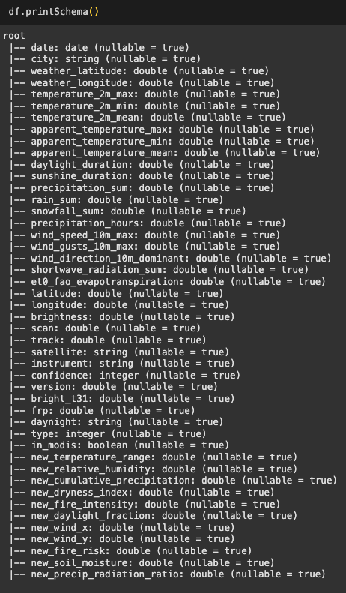
Data Analysis
Combining NASA FIRMS Data with Open Meteo Data, here is what we got.
Our analysis includes:
Feature Analysis
Analysis Per City
Yearly Trend Analysis

Slide 10
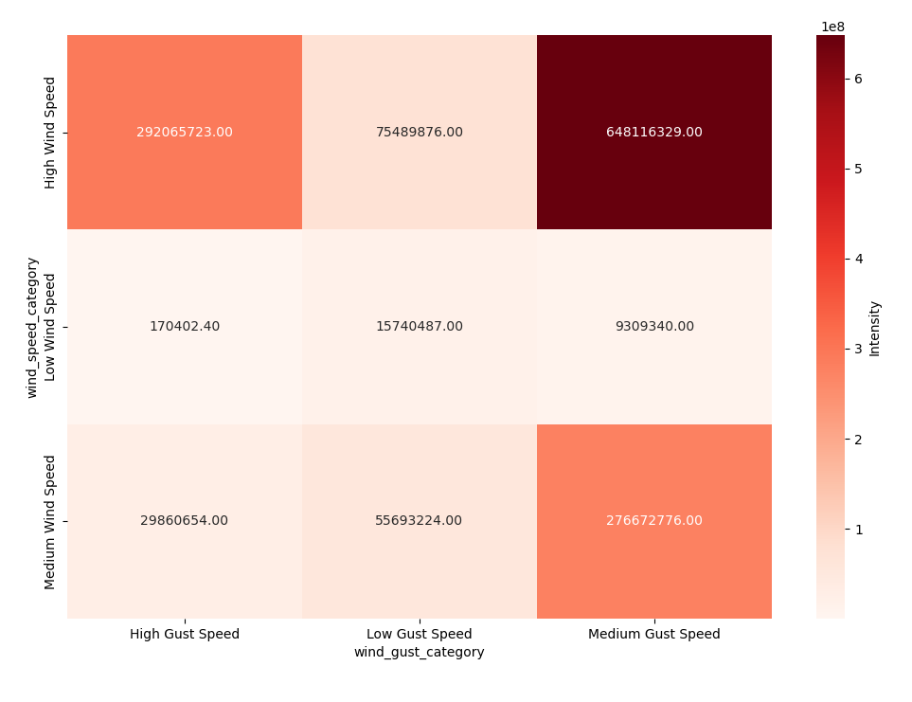
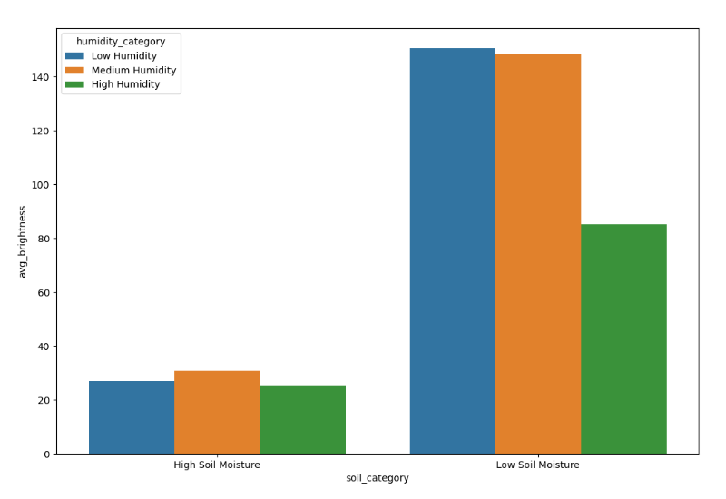
Feature Analysis
Wind Analysis
Soil Analysis

Slide 11
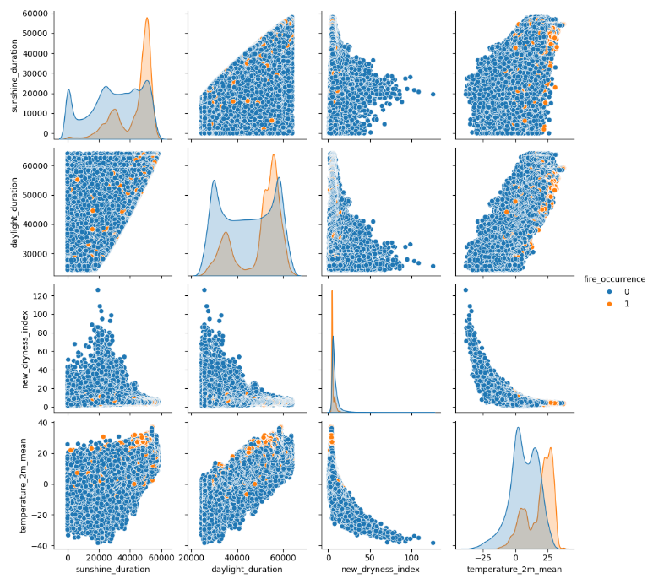
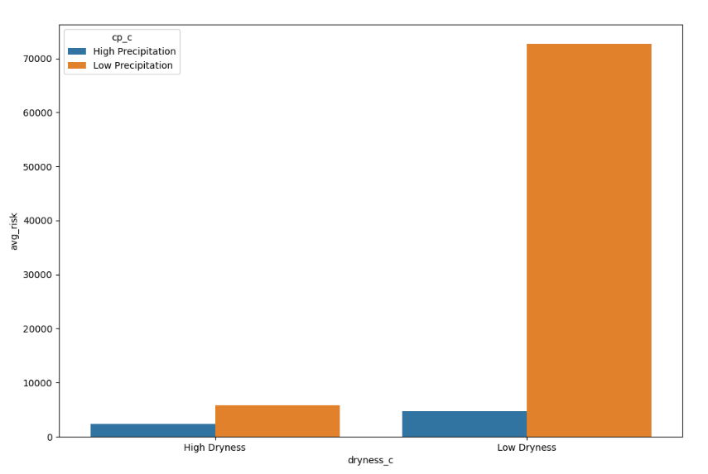
Feature Analysis
Fire Risk Analysis
Feature Correlation

Slide 12
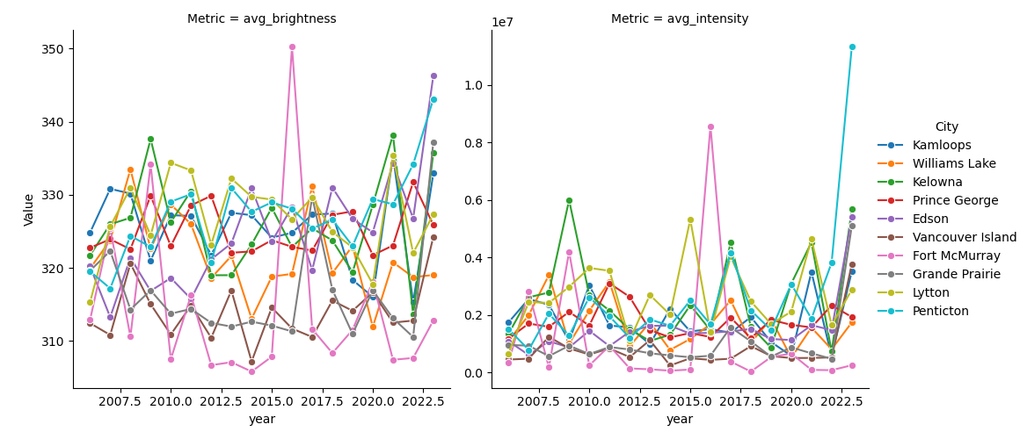
Feature Analysis
Average intensity and brightness per city by year

Slide 13
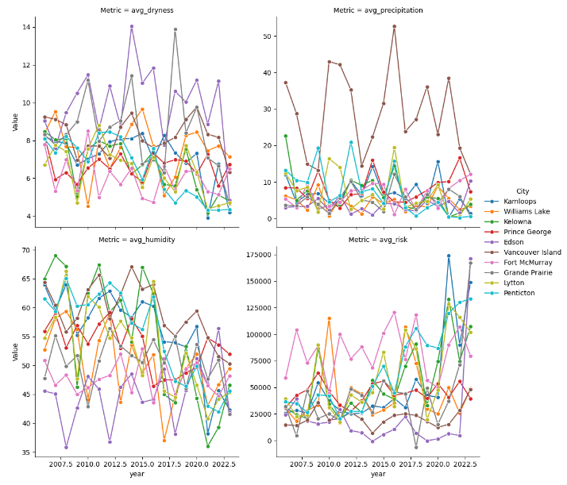
Feature Analysis
Yearly City Trend

Slide 14
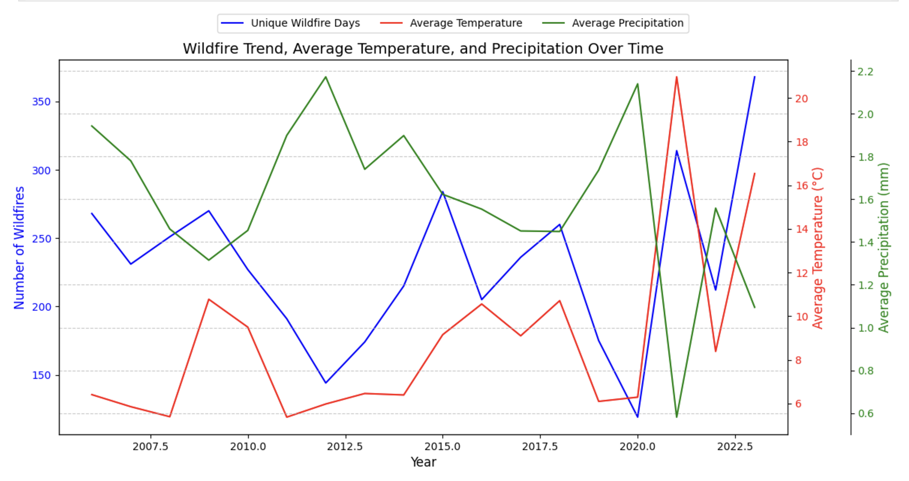
Feature Analysis

Slide 15
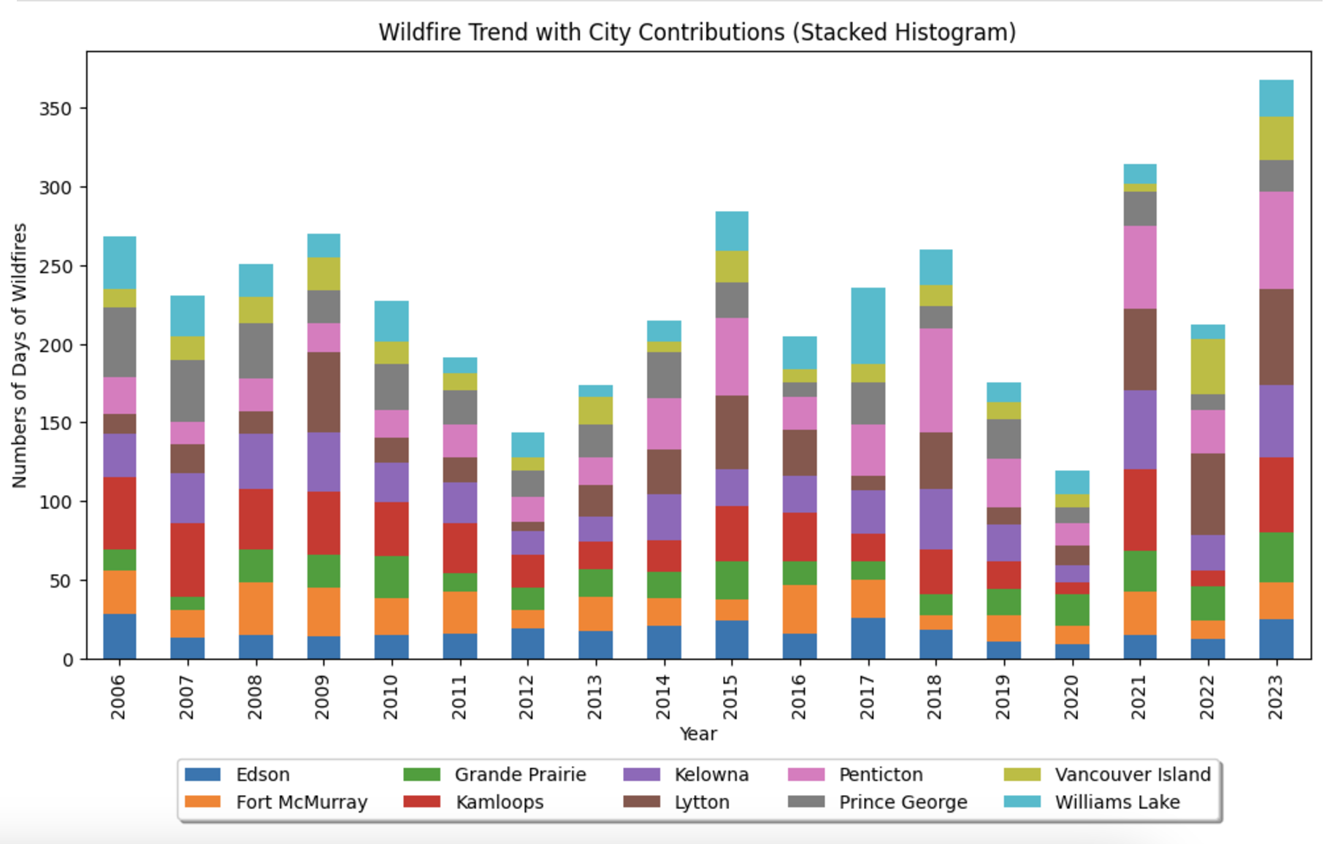
Feature Analysis

Slide 16
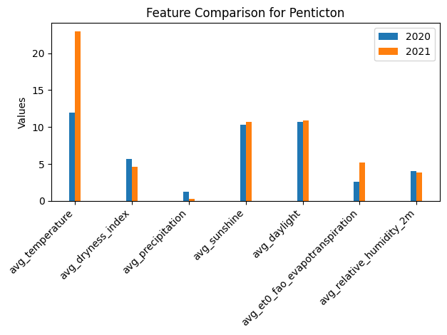
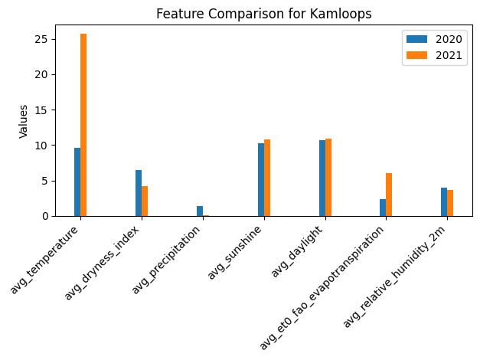
Feature Analysis

Slide 17
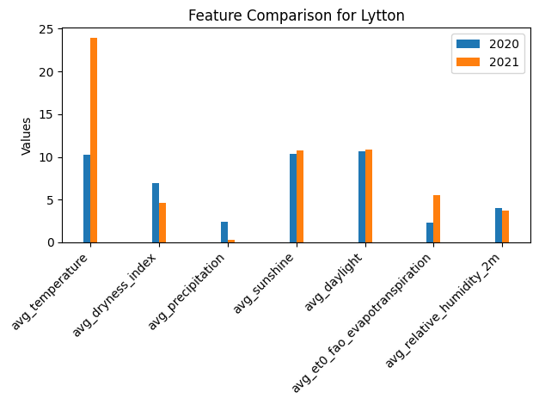
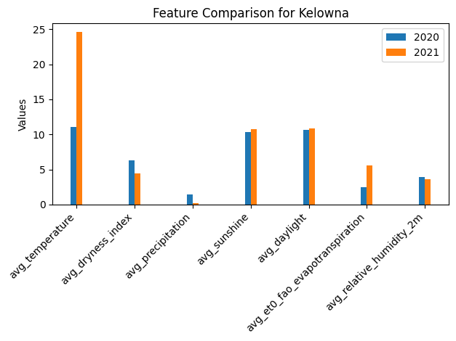
Feature Analysis

Slide 18
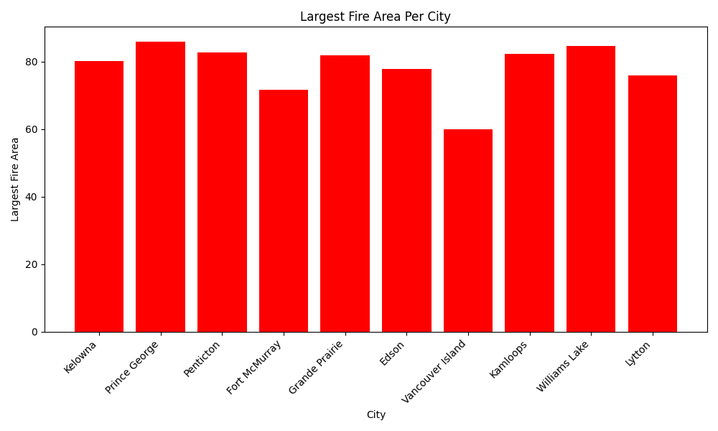
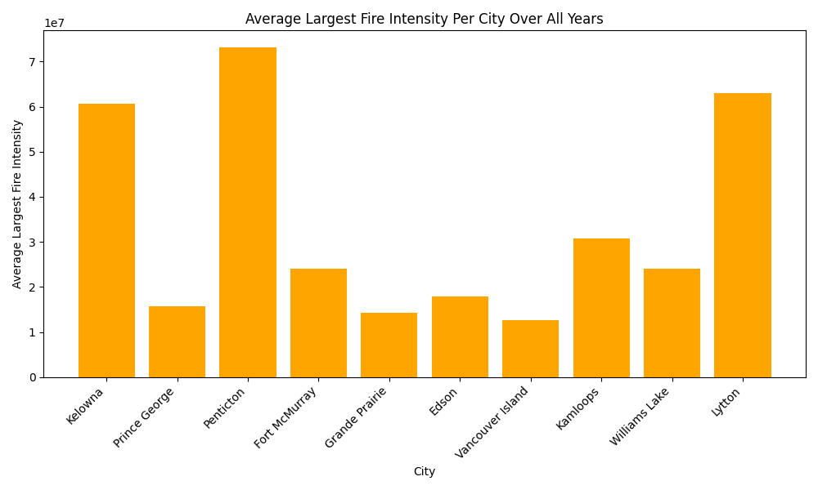
Feature Analysis

Slide 19
04
Machine Learning

Slide 20
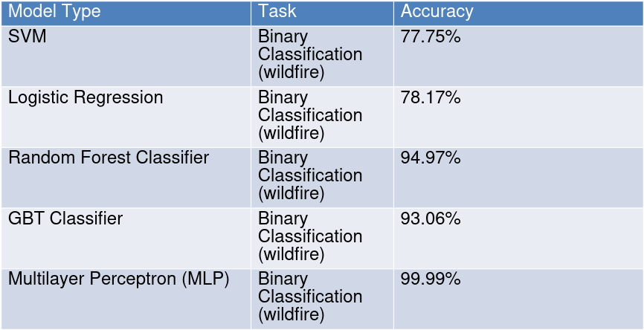
Classification

Slide 21
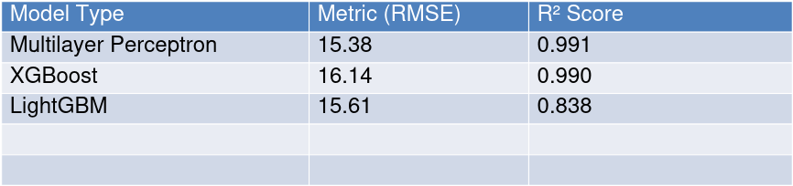
Regression (Brightness)

Slide 22

Regression (Confidence)

Slide 23
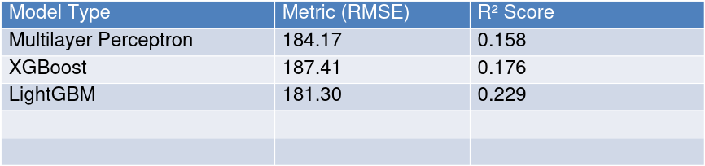
Regression (frp)

Slide 24
05
Conclusion

Slide 25
Conclusion
Key Findings:
Brightness is a strong predictor of wildfire occurrence, especially under dry and warm conditions.
High brightness correlates with extreme weather patterns, serving as a valuable indicator for fire risk in regions with heightened temperatures and dry spells.
Geographic Insights:
Cities like Kamloops, Penticton, and Kelowna exhibit consistently high brightness values and elevated wildfire risks.
These areas require targeted interventions due to the combination of persistent dryness, temperature spikes, and environmental vulnerability.
Environmental Trends:
Increasing temperatures and decreasing precipitation significantly influence wildfire patterns.
The rising frequency and intensity of wildfires highlight the urgency of monitoring these environmental trends for better wildfire management.

Slide 26
Conclusion(cont.)
Machine Learning Model Performance:
Brightness Prediction:
Neural networks achieved the best results with RMSE: 15.38 and R²: 0.991.
XGBoost also performed well (RMSE: 16.14, R²: 0.99), while LightGBM was a good alternative (RMSE: 15.61, R²: 0.837).
Wildfire Classification:
Neural networks (MLP) achieved the highest accuracy (99.1%), followed by Random Forest (94.9%).
Logistic Regression and SVM also performed well but were slightly less accurate.
Overall Regression Performance:
Neural networks (MLP) outperformed others (R²: 0.99, RMSE: 15.38), with XGBoost and LightGBM as close alternatives.
Conclusion: Our findings highlight the critical role of brightness and environmental factors in wildfire prediction, with neural networks demonstrating superior performance across prediction and classification tasks.

Slide 27
Thank you!

